Slide 1
Year 6
SATs Meeting
(2023)

Slide 2
KS2 Test week:
Results back in July
Notes:
.
Access arrangements: there are some ch for whom we have applied for extra time or to have rest breaks (it’s a very strict and lengthly process & we have to have evidence that the child has special ed needs) These ch can have 25% extra time. We’ve submitted and had 6 children accepted.
In previous years, you’ve all been so supportive and have loaned out your TAs for the week, this makes a huge difference for the children, enabling readers etc so thankyou & we will be asking for the same this year!

Slide 3
KS2 Grammar, Punctuation & Spelling (SPaG):
There is greater focus on knowing grammatical terminology
(eg “subjunctive form” “subordinating conjunctions” etc)

Slide 4
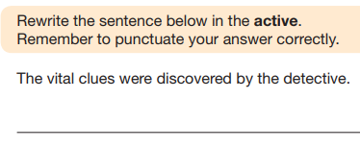
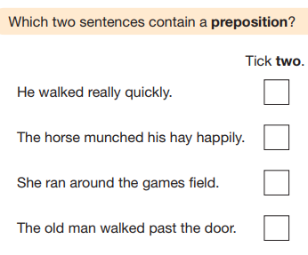

Slide 5
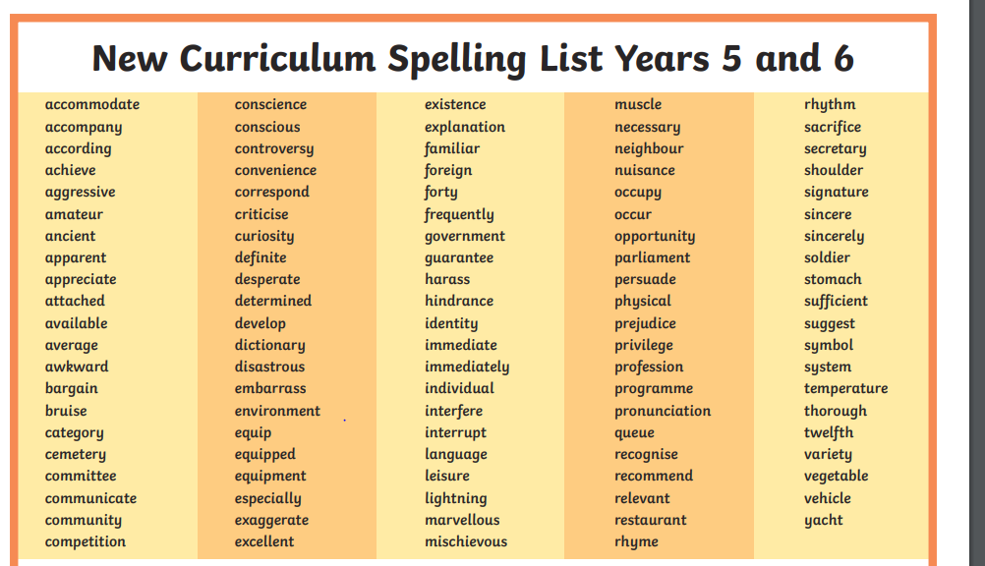
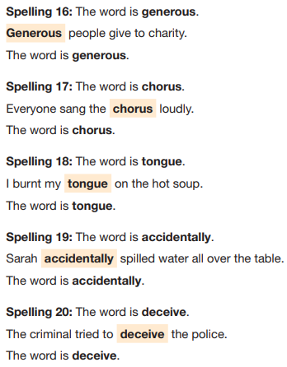
20 Marks
Spelling – 20 words based on spelling rules

Slide 6
KS2 Reading Paper:
1 hour (3 texts with accompanying
questions)
Roughly 40 questions to answer.
Combination of fiction, poetry and
Non-fiction texts.
Please have a look at your copy of last
year’s reading paper.

Slide 7
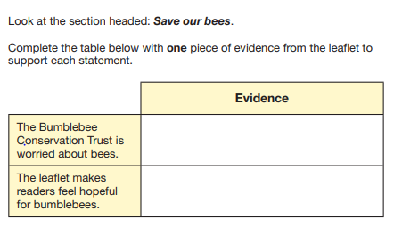
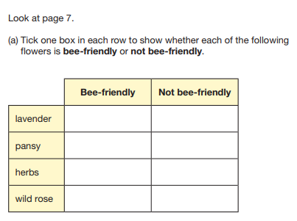

Slide 8
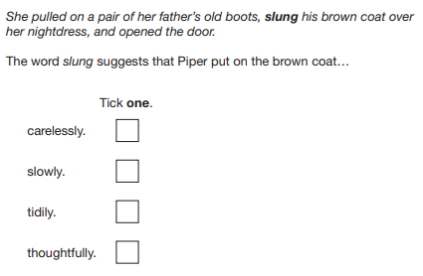
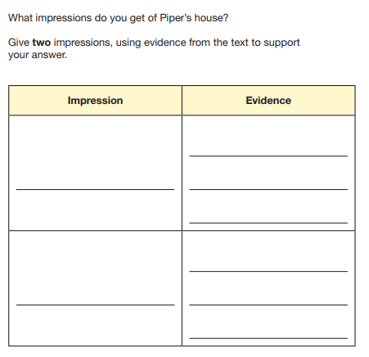
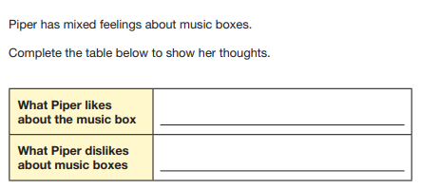

Slide 9
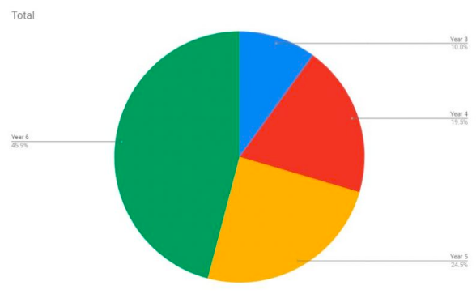
KS2 Maths:
Arithmetic Test (30 minutes)
36 questions

Slide 10
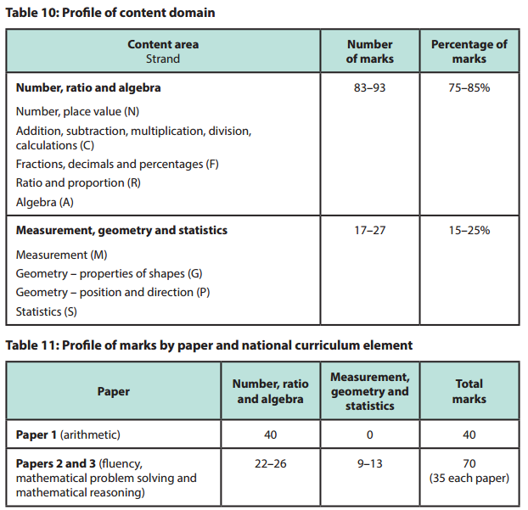

Slide 11
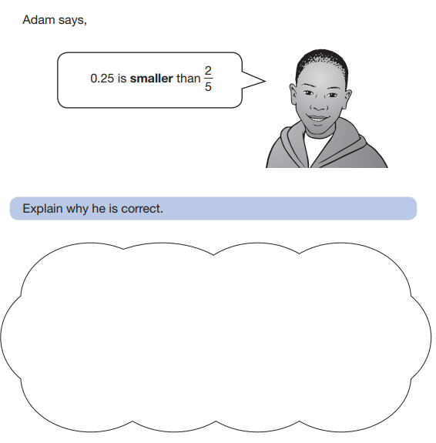
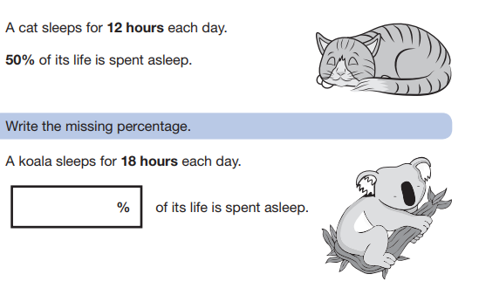
Reasoning Papers 2 and 3:
40 minutes per paper
Multi-step problems testing skill of using and applying knowledge.

Slide 12
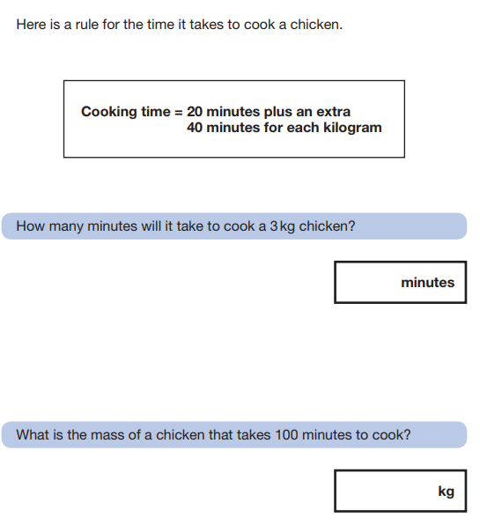
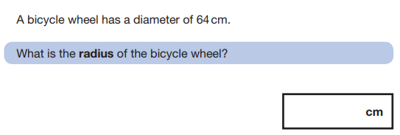
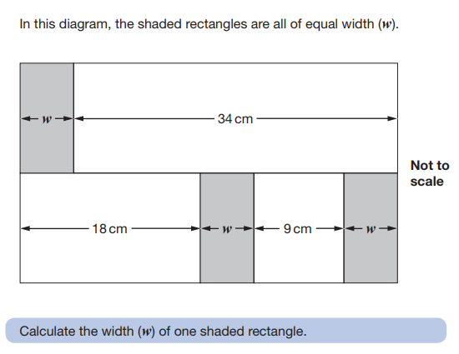
Reasoning Papers 2 and 3:

Slide 13
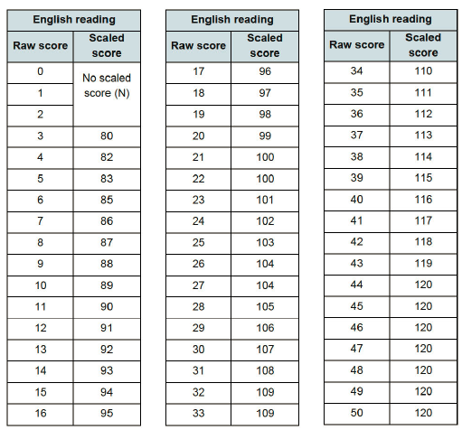
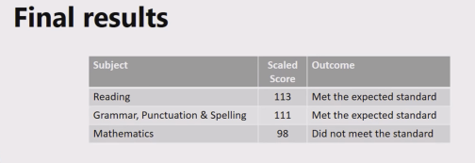
Results

Slide 14
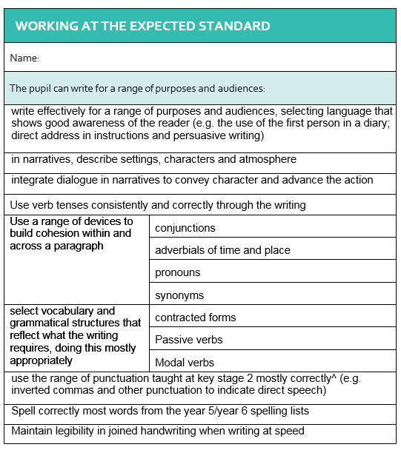
KS2 Writing:

Slide 15
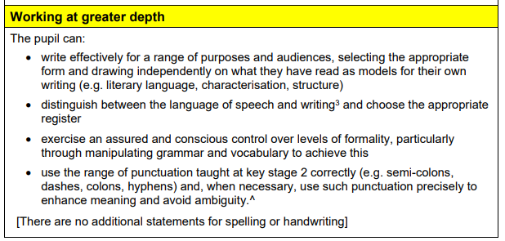

Slide 16
Preparation
Testing weeks (December, February, March)Results will be given to the children and shared at parents’ evenings so you can see progress they have made
Homework groups – start January
Homework based reading!
Daily SPAG starters

Slide 17
SATs week - Breakfast club
In order to give them the best possible start, it’s important that they are hydrated, calm and have eaten a substantial breakfast.
With this in mind we are offering a ‘Breakfast club’ where we will provide toast, cereal bars and juice. Come in to the Y6 Block Area between 8:15am and 8:30am.
At break time we will also be giving children a piece of fruit to keep them energised.
Notes:
R

Slide 18
How to help over SATs week …
Make sure children get plenty of sleep.
Please make sure they arrive on time – 8.45 or before if attending breakfast club.
Please make sure they do not miss any of the tests.
Carry on with normal after-school activities as it will help them to relax and unwind.
Notes:
R

Slide 19
Resources

Slide 20
Any Questions?

